Slide 1

AI in CyberSecurity
How Artificial Intelligence is Transforming Cybersecurity
Presented By
Rohan Rahim
Shafayat Bin Islam
SM Samauzzaman Zayed
1

Slide 2
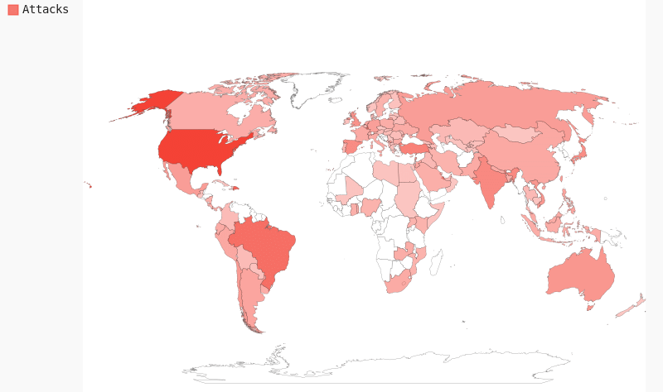
Why Cybersecurity Needs AI?
The rise of cyber threats
Traditional security measures are not enough
AI’s ability to detect and respond in real-time
2

Slide 3
The Rising Cyber Threat
Landscape
Types of Cyber Threats AI Can Counter:
Malware & Ransomware
Phishing Attacks Advanced
Persistent Threats (APTs)
Zero-Day Exploits
Insider Threats
3

Slide 4
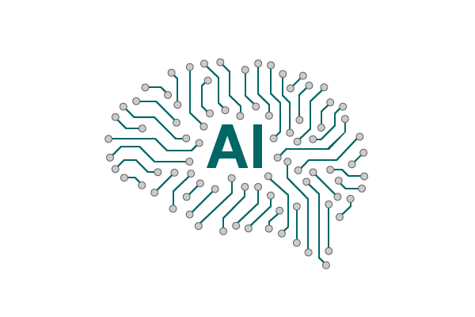
Understanding AI in Cybersecurity
What is AI?
AI refers to machines mimicking human intelligence
Key AI techniques: Machine Learning (ML), Deep Learning (DL),
Natural Language Processing (NLP)
4

Slide 5
Machine Learning (ML) in Cybersecurity
How ML Works in Security:
Analyzes large datasets
Identifies patterns in cyber threats
Improves threat detection accuracy
Feature | Traditional Security | ML-Based Security
Speed | Manual detection | Real-time detection
Accuracy | Prone to false positives | Higher accuracy
Adaptability | Cannot learn | Continuously improves
Comparison of ML-based security vs. traditional security
5

Slide 6
Deep Learning (DL) in Cybersecurity
Advantages of Deep Learning:
Detects new, unknown threats
Self-improving AI models
Used in image recognition, anomaly
detection, deepfake identification
Example:
AI analyzing malware behavior instead of relying on signature-based detection
6

Slide 7
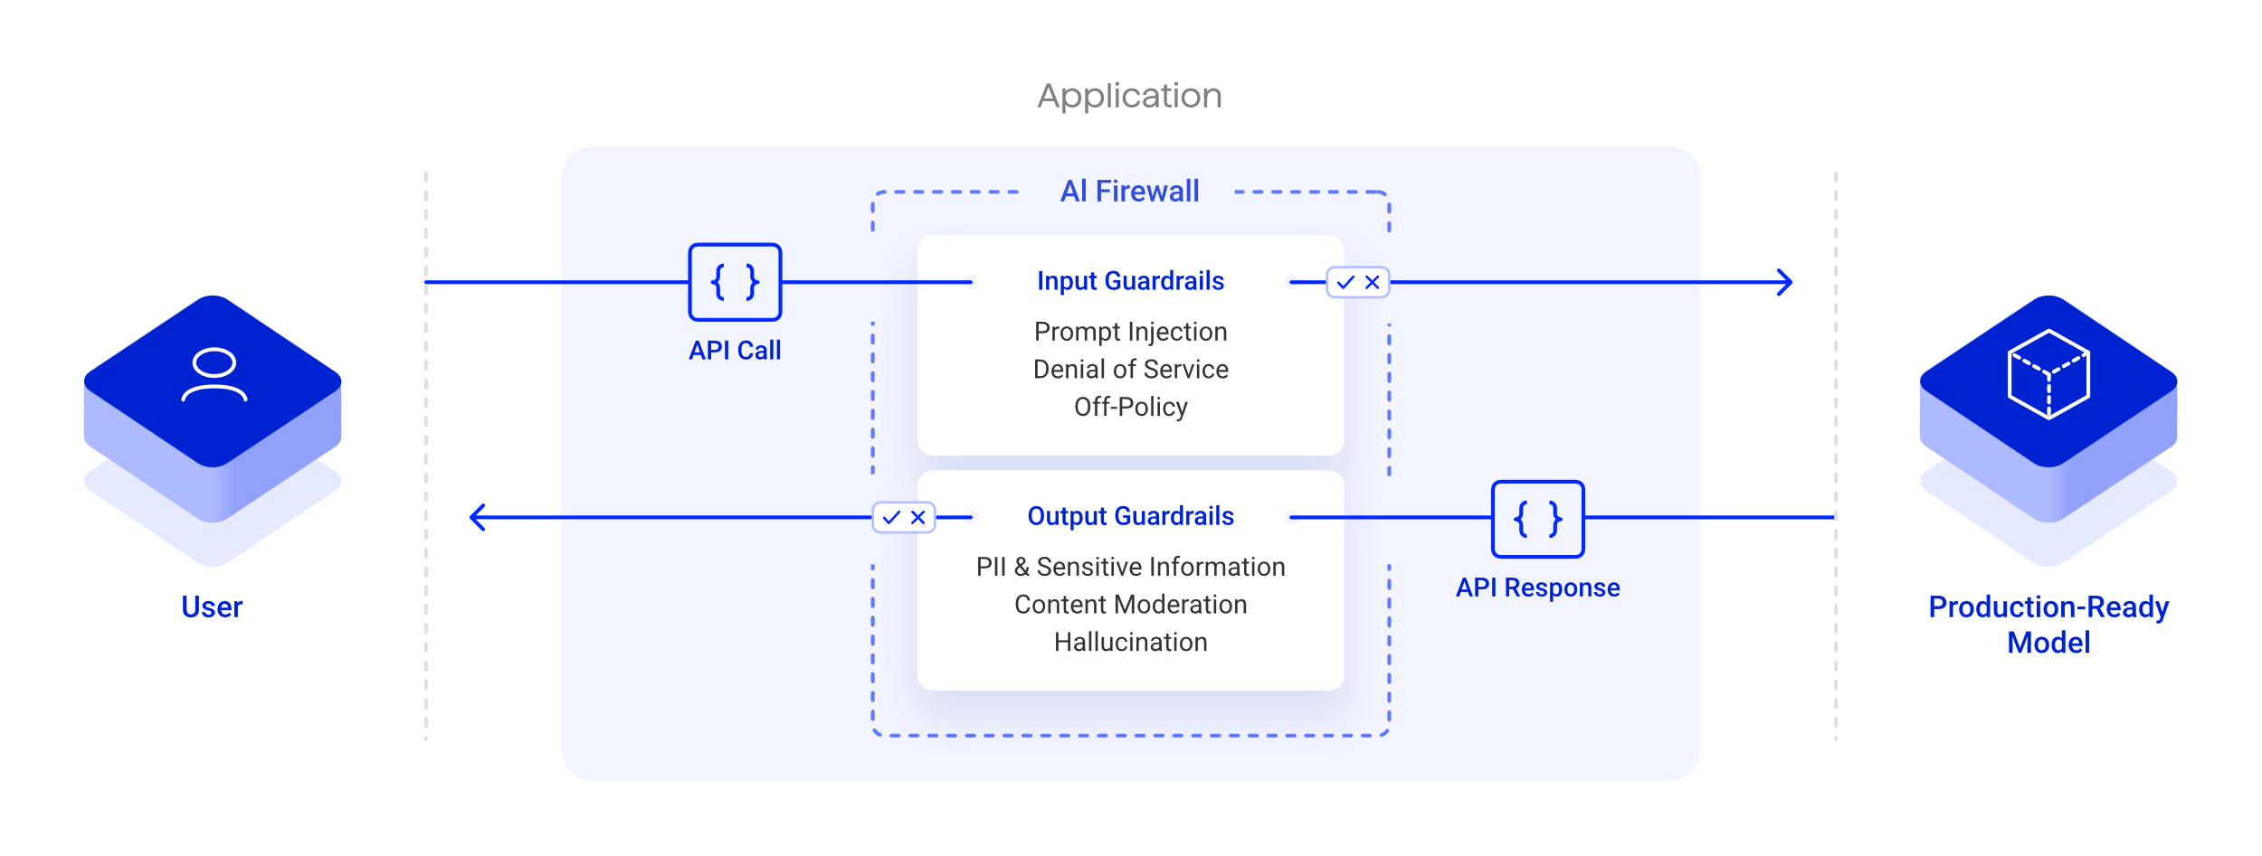
AI in Threat Detection
AI analyzes network traffic and user behavior
Identifies suspicious activities before a breach happens
7

Slide 8
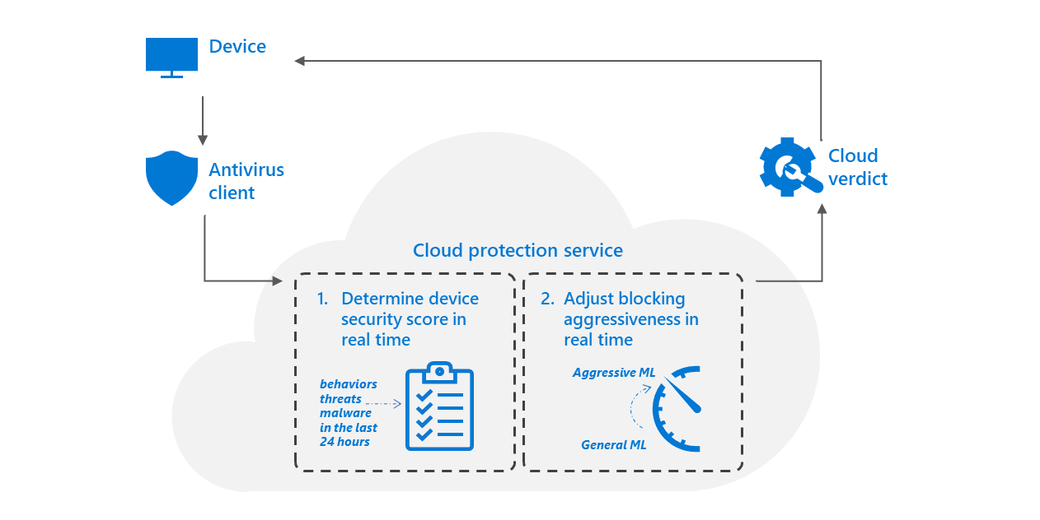
AI in Malware Detection
How AI Helps in Malware Detection:
AI scans software behavior instead of relying on virus signatures
Identifies new variants of malware
Example:
Microsoft Defender using AI for malware prevention
8

Slide 9

AI in Phishing Detection
AI Detects Phishing Emails & Websites:
Analyzes email content, sender behavior, and URL structures
Blocks malicious emails in real-time
Example:
Gmail’s AI blocking 100M+ phishing emails daily
9

Slide 10
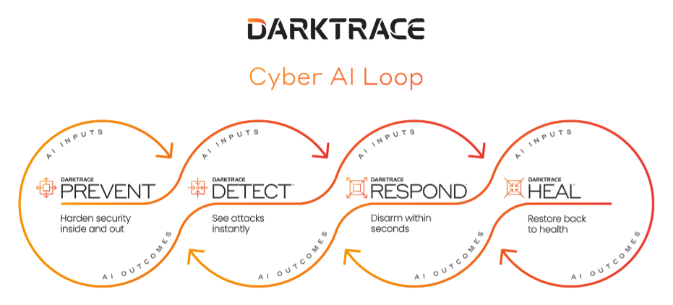
AI in Network Security
AI-powered Intrusion Detection Systems (IDS)
AI-based firewalls adapting to new attack patterns
Example:
Darktrace leverages machine learning to enhance cybersecurity by autonomously detecting, responding to, and mitigating threats in real-time
10

Slide 11
Behavioral Analysis with AI
AI detects deviations from normal user behavior
Feature | Traditional Detection | AI-Powered Detection
Speed | Slow manual process | Instant detection
Accuracy | High false positives | Reduced errors
Adaptability | Fixed rules | Learns and adapts
Example:
AI detecting hackers using stolen credentials
Traditional vs. AI-based anomaly detection
11

Slide 12
AI vs. Traditional
Cybersecurity
Key Differences:
AI offers real-time security vs. reactive security
AI-based tools evolve over time, traditional methods do not
12

Slide 13

AI in Incident Response
AI automates threat response
Example:
AI stopping ransomware encryption before it starts!
13

Slide 14
AI & Cyber Threat Intelligence
AI gathers and analyzes threat intelligence from various sources
AI predicts potential cyber-attacks before they occur
14

Slide 15
Challenges of AI in Cybersecurity
False positives & False Negatives
AI Model Bias
Adversarial Attacks (AI Manipulation)
15

Slide 16
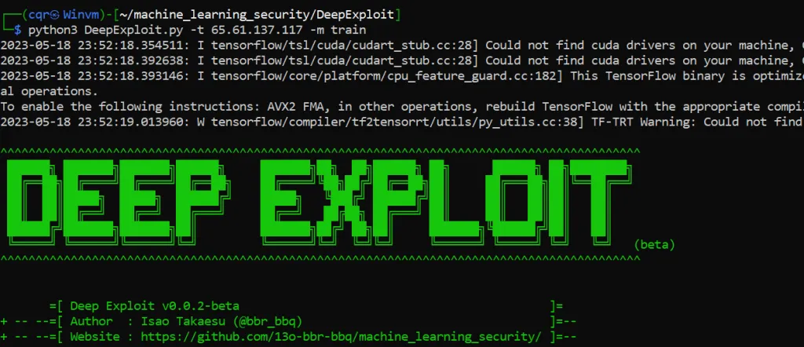
AI in penetration Testing
AI automates ethical hacking
Example:
DeepExploit is an AI-powered tool designed to automate penetration testing by leveraging machine learning models to perform attacks on vulnerable systems. It autonomously identifies weaknesses, carries out exploitation, and provides real-time feedback, making penetration testing faster, more efficient.
16

Slide 17

Deepfake & AI powered Attacks
Deepfake videos and voice fraud
Example:
AI voice cloning used for CEO fraud($35M stolen)
17

Slide 18
AI for Secure Authentication
AI enhances biometric(face recognition, fingerprint)
AI detects fraudulent login attempts
18

Slide 19
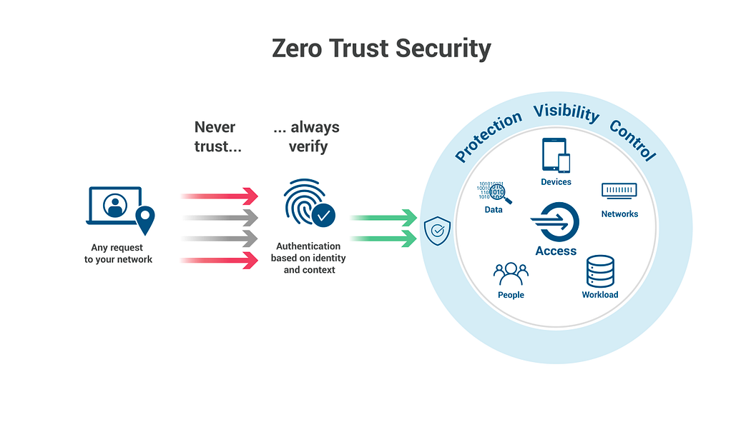
AI in Zero Trust Security Models
AI ensures continuous authentication
AI adapts access control based on risk level
19

Slide 20
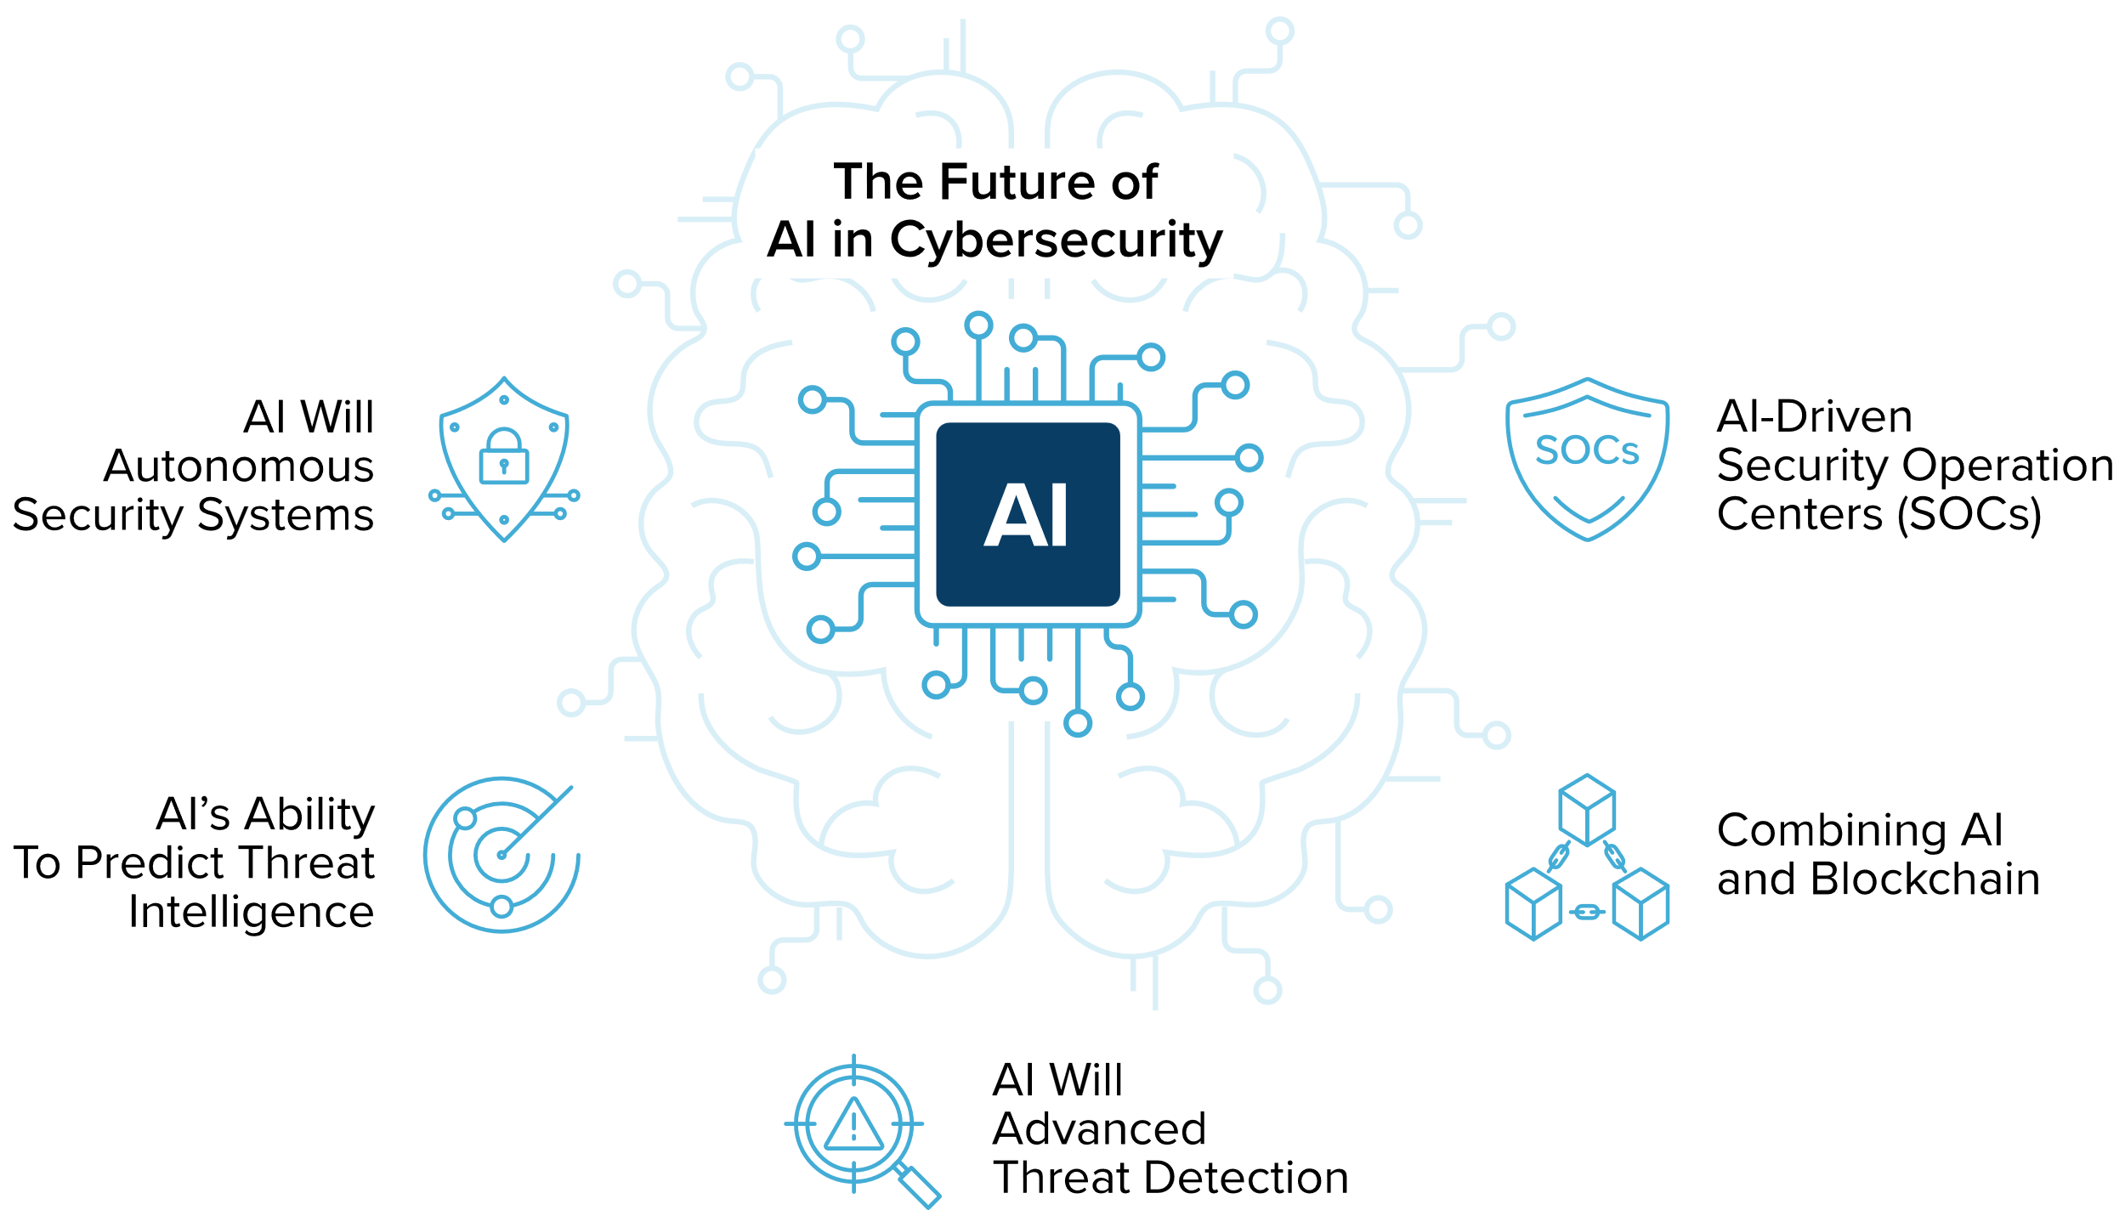
Future of AI in Cybersecurity
Self-learning AI models
AI-powered deception technology
Quantum AI Security
20

Slide 21
Case Study 1: AI preventing a Cyber Attack
Darktrace Stopping WastedLocker Ransomware
Darktrace’s AI detected and halted WastedLocker ransomware before encryption.
The AI flagged unusual behaviour and blocked the attack in real time.
Key Takeaway: AI enhances cybersecurity but human oversight is still needed to verify threats.
Source: Darktrace
21

Slide 22
Case Study 2: When AI Fails
AI Blocking Legitimate Transactions
In August 2024, Starling Bank’s AI mistakenly blocked a €15,000 transfer from Professor John MacInnes, flagging it as fraud.
Despite multiple verifications, the bank demanded excessive proof, delaying the transaction.
After media intervention, the bank unblocked the account and approved the transfer.
Source: The Guardian
Key Takeaway: AI improves fraud detection but isn’t perfect—human oversight is crucial to prevent false positives.
22

Slide 23
Ethical Concerns of AI in Cybersecurity
Ethical Concerns of AI
AI model Bias
Privacy Concerns
Accountability Issues
AI model Bias
Privacy Concerns
Accountability Issues
23

Slide 24
Summary & Key Takeaways
AI is transforming cybersecurity
AI is fast and adaptive but has challenges
Future of AI models will be more autonomous and resilient
24

Slide 25
Thank You for Your Time!
25

